Slide 1
Idea
Technology Slack we are using!
Solution
Problem statement
Organizing Campaigns at regular intervals based on a volunteer system and bot System(using azure bot service).
Creating a website (SWARLIPI) with free study resources, an opportunity page for girls, courses, and all other academic stuff on a single website.
This website will have a sign-up page through which each school can get themselves registered with the portal and access the free resources.
Validation through Aadhar card Number before any organization, student, or volunteer connects and gets registered with us. This step is just to prevent any kind of malpractices.
We would also link our page with a few other organization links that are featuring same issues as Desh Ke Mentor and Umang.
Similar websites would have a form for volunteer participants who would like to volunteer in the campaigns.
Tech-Based solution for
women’s Empowerment
in India
VS Code
HTML
CSS
JAVASCRIPT
Node JS
Microsoft Azure Bot Service
Microsoft Database Service
MongoDB
D
We're developing a website for rural women which provides unlimited learning resources, an opportunity page, courses, and all academic information in a single window. Will be easy to access and will be mentored regularly by volunteers and a system bot. This website contains hundreds of courses organized by class and stream. With the help of the system bot, we recommend new courses based on your interests and background.
Invent tech-based solutions
for Women’s Empowerment
in India.
C
B
A
Theme: Devise tech-based solutions to make education accessible to rural women.
Team: Meraki_Coders
Institute: Indian Institute of Information Technology Bhagalpur

Slide 2
Suppose a family from a village who belongs from a farming background has no idea about where to let her girl educate and didn't have enough resources. So, in this case, the campaign led by our SWARLIPI organization on regular Intervals would be helping many such parents to clear their doubts and girls to get into the path of being a successful human being.
Due to lack of resources and knowledge to an individual we (SWARLIPI organization) would be providing our portal support to government schools so that the linked resources and websites could be used for providing educational resources and various opportunities and mentorship for the same.
USE CASES

Slide 3
Manual updation of the data and resources on the official website.
Collection of Aadhar card information and its API linking.
Copyright issue on linking of few Websites to our website like Desh ke Mentor, Umang.
DEPENDENCIES/SHOW STOPPER

Slide 4
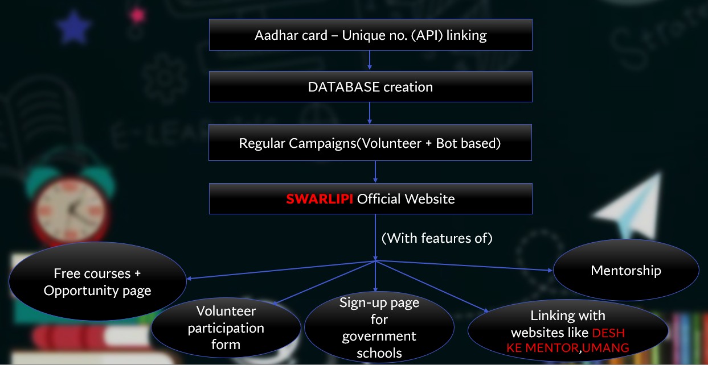
FLOWCHART

Slide 5
To include an automatic attendance record system.
To include the FAQ section on the website.
To collaborate with other organizations to increase girls’ literacy, aiming at up to 100%.
FUTURE PLANS

Slide 6
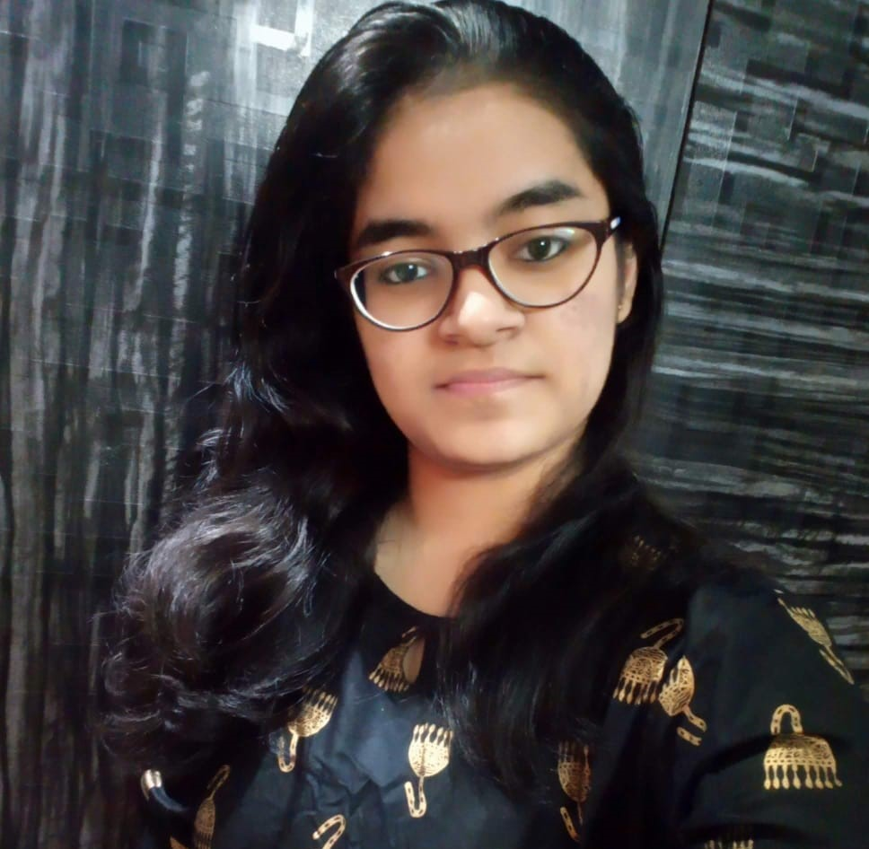
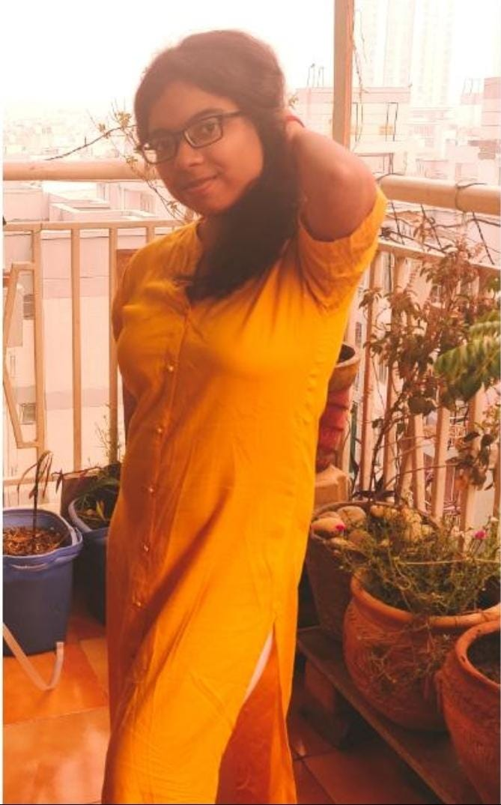
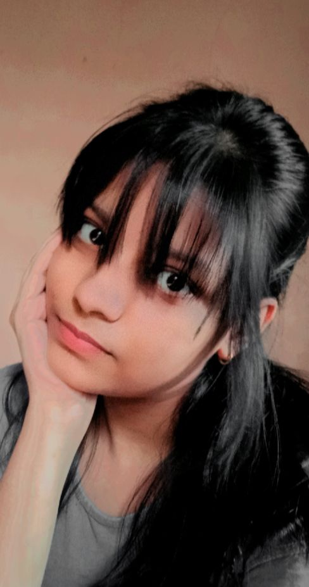
Priya Mishra
Team Leader
Email id- priyamishra3009@gmail.com
Ishika Jha
Email id- jhaishika2003@gmail.com
Syankita
Email id- syankitas1d@gmail.com

